Slide 1
Digital Logic Design
CSE 232 Computer systems Fundamentals
Dr. Gamal Fahmy
Multiplexers and Decoders

Slide 2
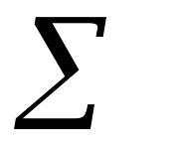
Multiplexers
Y
X
Z
T
Motivation
Mux
Mux
Multiplexer (Mux)-Routes one of many inputs to one output.
Decoder (Demultiplexer DeMux)-Routes one input to one of many outputs.
Decoder
Route to Device B
Route to Device A
© Gamal Fahmy

Slide 3
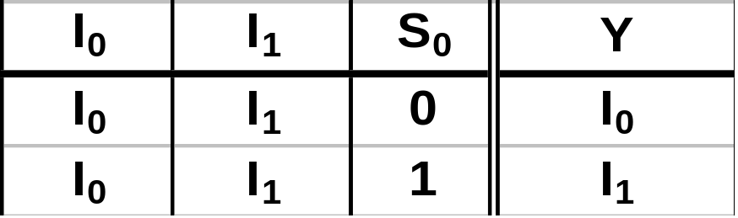
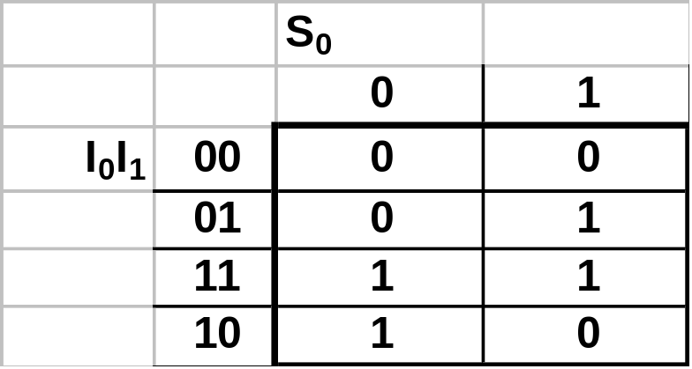
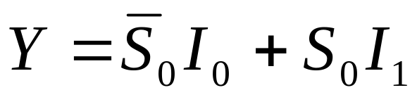
Multiplexers
Starting w/ the Mux function definition, lets design a Mux.
2:1
Mux
I₀
Y
Y
I₁
S₀
Could write this down by inspection.
© Gamal Fahmy

Slide 4
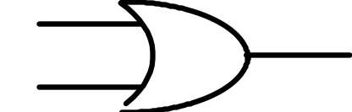
Multiplexers
Lets build the Mux using AND/OR.
2:1
Mux
I₀
Y
I₁
S₀
S₀
I₀
Y
I₁
© Gamal Fahmy

Slide 5
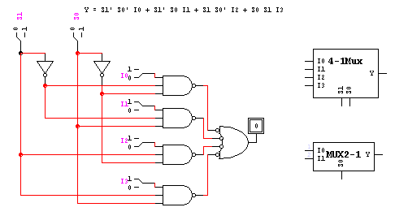
Multiplexers
Derive the output equation for a 4:1 mux.
I₀
4:1
Mux
I₁
Y
I₂
I₃
S₁
S₀
© Gamal Fahmy

Slide 6
Multiplexers
I₀
Using 4:1 and 2:1 mux’s give a paper design for an 8:1 Mux. Label input/output according to the convention discussed.
4:1
Mux
I₁
Y
I₂
I₃
S₁
S₀
2:1
Mux
I₀
Y
I₄
4:1
Mux
I₁
S₃
I₅
Y
I₆
I₇
S₁
S₀
© Gamal Fahmy

Slide 7
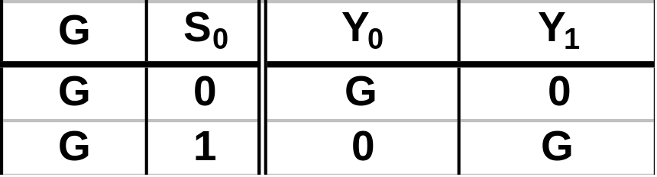
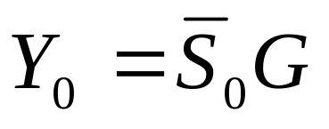
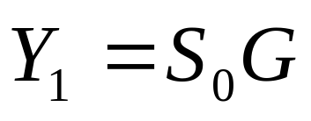
Decoders
Starting w/ the decoder/demux function definition, lets design a decoder/demux.
Y₀
1:2
DeMux
G
Y₁
By inspection:
S₀
© Gamal Fahmy

Slide 8
Decoders
Lets build the decoder/demux using AND/OR logic.
Y₀
S₀
1:2
DeMux
G
Y₀
Y₁
S₀
Y₁
G
© Gamal Fahmy

Slide 9
Decoder
Derive the output equations* for a 2:4 decoder/demultiplexer.
Y₀
2:4
DeMux
Y₁
G
Y₂
S₁
S₀
Y₃
© Gamal Fahmy

Slide 10
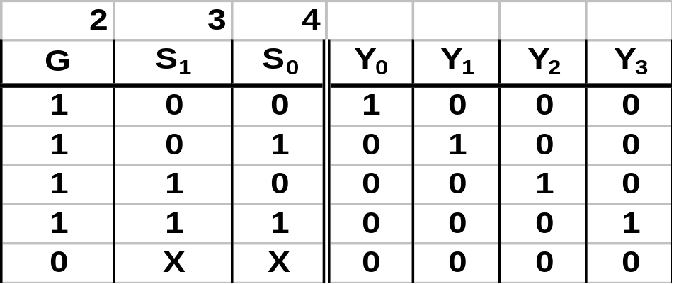
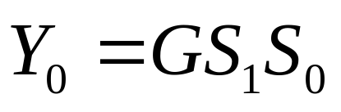
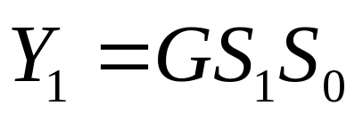
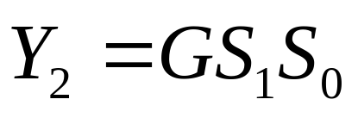

Decoder
Decoder/Demultiplexer
Y₀
2:4
DeMux
Y₁
Data In
G
Y₂
Enable
Decoder
By inspection:
Y₃
S₁
S₀
© Gamal Fahmy

Slide 11
Decoder
Y₃
1:2
DeMux
G
Y₂
Y₃
S₁
1:2
DeMux
G
Y₂
S₀
Y₀
1:2
DeMux
G
Y₁
S₁
© Gamal Fahmy

Slide 12
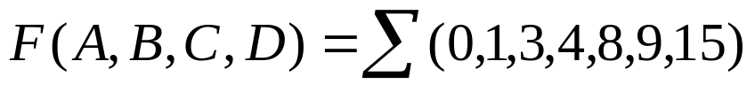
Problem
Implement the following boolean function with a multiplexer
CHECK the BOARD
© Gamal Fahmy

Slide 13
Decoder & Encoder
3 X 8
Decoder
3 X 8
Encoder
CHECK the BOARD
© Gamal Fahmy

